Slide 1
Adjoint Monte Carlo Electron Transport in the Continuous-Slowing-Down Approximation
J. A. Halbleib and J. E. Morel (1980)

Slide 2
Adjoint Electron Transport
Delayed development paralleling that of forward electron transport
At the time only one published work
T. M. Jordon (1976)
Multi-group
Green’s function formalism

Slide 3
Overview of Method
Describes transport of primary electrons
1D
Condensed History method
Goudsmit-Saunderson Multiple Elastic Scattering Theory for angular deflections
Averaged over random walk segments using the method of Spencer
Continuous Slowing Down Approximation for energy loss and deposition
The Nearest-Grid-Point (NGP) method
Uninterpolated tabular data only

Slide 4
Overview of Method
Continuous Slowing Down Approximation (CSDA)
Ignores energy loss caused by the production of δ-rays, Bremsstrahlung photons, and energy straggling
Goudsmit-Sauderson and Moliere multiple scattering theories

Slide 5
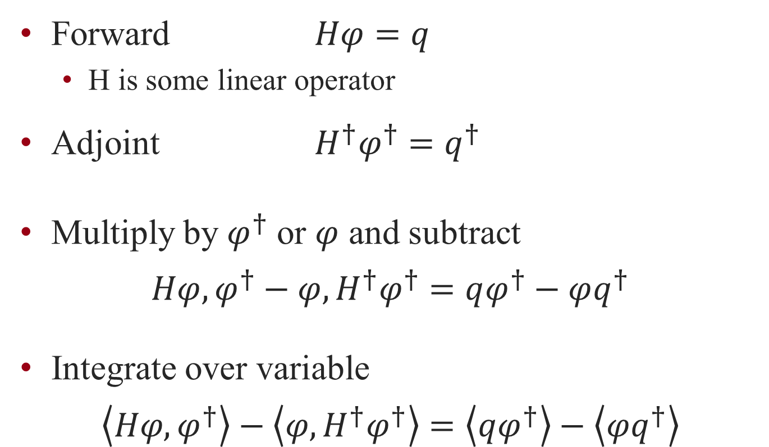
Forward-Adjoint Formalism
Forward $Hφ=q$
H is some linear operator
Adjoint $H^{†}φ^{†}=q^{†}$
Multiply by $φ^{†}$ or $φ$ and subtract
$$Hφ,φ^{†}−φ,H^{†}φ^{†}=qφ^{†}−φq^{†}$$
Integrate over variable
$$\left\langle Hφ,φ^{†}\right\rangle −\left\langle φ,H^{†}φ^{†}\right\rangle =\left\langle qφ^{†}\right\rangle −\left\langle φq^{†}\right\rangle$$

Slide 6
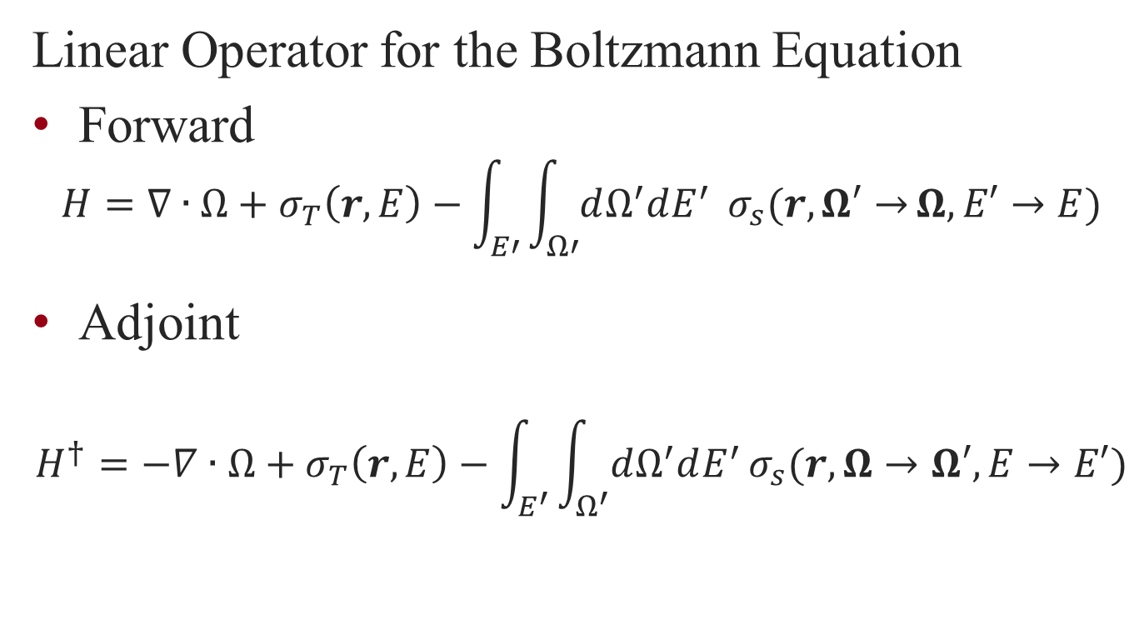
Forward-Adjoint Formalism
Linear Operator for the Boltzmann Equation
Forward
$$H=∇∙Ω+σ_{T}\left(r,E\right)−\int_{E′}{\int_{Ω′}{dΩ^{′}dE^{′}} σ_{s}(r,Ω′→}Ω,E′→E)$$
Adjoint
$$H^{†}=−∇∙Ω+σ_{T}\left(r,E\right)−\int_{E^{′}}{\int_{Ω^{′}}{dΩ^{′}dE^{′}}}σ_{s}(r,Ω→Ω′,E→E′)$$

Slide 7
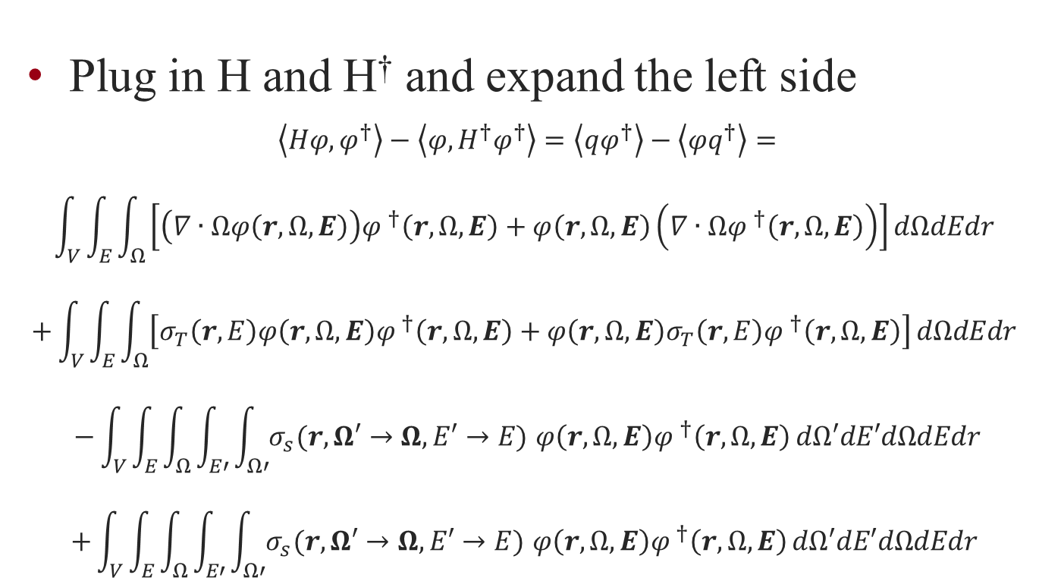
Forward-Adjoint Formalism
Plug in H and H† and expand the left side
$$\left\langle Hφ,φ^{†}\right\rangle −\left\langle φ,H^{†}φ^{†}\right\rangle =\left\langle qφ^{†}\right\rangle −\left\langle φq^{†}\right\rangle =$$
$$\int_{V}{\int_{E}{\int_{Ω}{\left[\left(∇∙Ωφ\left(r,Ω,E\right)\right){φ }^{†}\left(r,Ω,E\right)+φ\left(r,Ω,E\right)\left(∇∙Ω{φ }^{†}\left(r,Ω,E\right)\right)\right]}}dΩdEdr }$$
$$+\int_{V}{\int_{E}{\int_{Ω}{\left[σ_{T}\left(r,E\right)φ\left(r,Ω,E\right){φ }^{†}\left(r,Ω,E\right)+φ\left(r,Ω,E\right)σ_{T}\left(r,E\right){φ }^{†}\left(r,Ω,E\right)\right]}}dΩdEdr }$$
$$−\int_{V}{\int_{E}{\int_{Ω}{\int_{E′}{\int_{Ω′}{σ_{s}(r,Ω′→Ω,E′→E) φ\left(r,Ω,E\right){φ }^{†}\left(r,Ω,E\right)}}dΩ′dE′dΩdEdr}}}$$
$$+\int_{V}{\int_{E}{\int_{Ω}{\int_{E′}{\int_{Ω′}{σ_{s}(r,Ω′→Ω,E′→E) φ\left(r,Ω,E\right){φ }^{†}\left(r,Ω,E\right)}}dΩ′dE′dΩdEdr }}}$$
Notes:
2: =0
3+4: =0

Slide 8
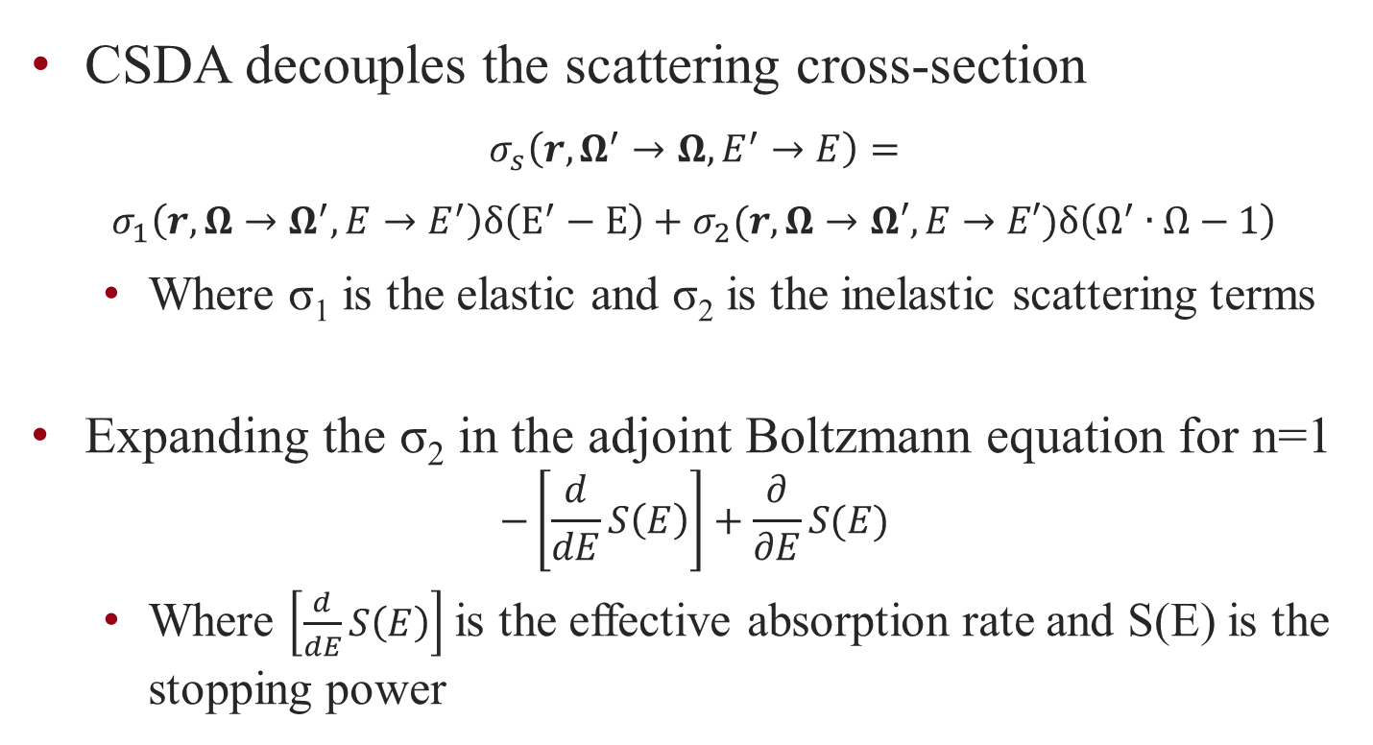
CSDA Formalism
CSDA decouples the scattering cross-section
$$σ_{s}\left(r,Ω^{′}→Ω,E^{′}→E\right)=$$
$$σ_{1}\left(r,Ω→Ω^{′},E→E^{′}\right)δ\left(E^{′}−E\right)+σ_{2}(r,Ω→Ω′,E→E′)δ\left(Ω^{′}∙Ω−1\right)$$
Where σ₁ is the elastic and σ₂ is the inelastic scattering terms
Expanding the σ₂ in the adjoint Boltzmann equation for n=1
$$−\left[\frac{d}{dE}S\left(E\right)\right]+\frac{∂}{∂E}S(E)$$
Where $\left[\frac{d}{dE}S\left(E\right)\right]$ is the effective absorption rate and S(E) is the stopping power
Notes:
Elastic electron-nuclear scattering
Inelastic electron-electron

Slide 9
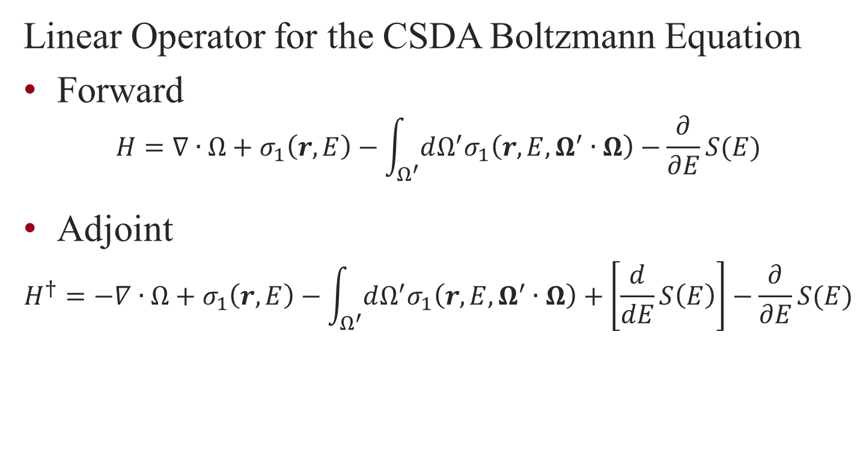
Forward-Adjoint Formalism
Linear Operator for the CSDA Boltzmann Equation
Forward
$$H=∇∙Ω+σ_{1}\left(r,E\right)−\int_{Ω^{′}}{dΩ^{′}σ_{1}\left(r,E,Ω^{′}∙Ω\right)}−\frac{∂}{∂E}S(E)$$
Adjoint
$$H^{†}=−∇∙Ω+σ_{1}\left(r,E\right)−\int_{Ω^{′}}{dΩ^{′}σ_{1}\left(r,E,Ω^{′}∙Ω\right)}+\left[\frac{d}{dE}S\left(E\right)\right]−\frac{∂}{∂E}S(E)$$

Slide 10
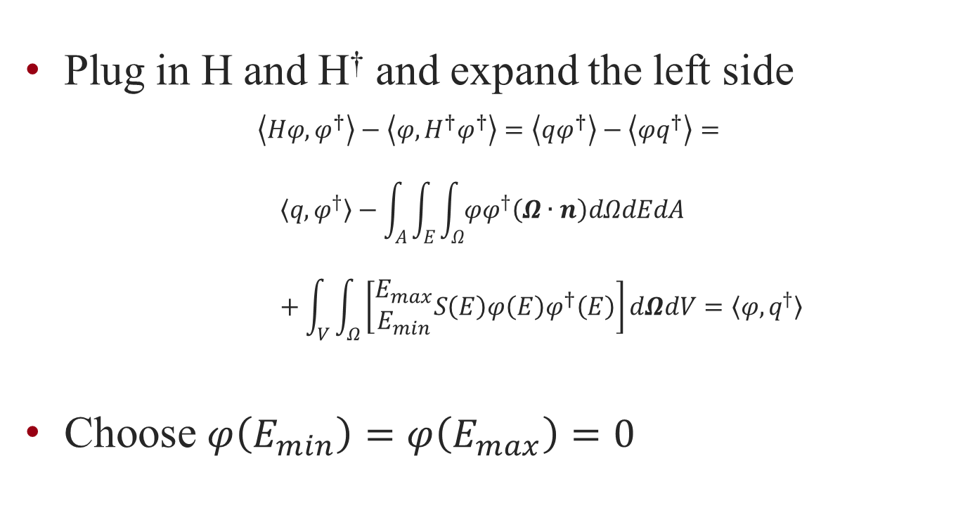
Forward-Adjoint Formalism
Plug in H and H† and expand the left side
$$\left\langle Hφ,φ^{†}\right\rangle −\left\langle φ,H^{†}φ^{†}\right\rangle =\left\langle qφ^{†}\right\rangle −\left\langle φq^{†}\right\rangle =$$
$$〈q,φ^{†}〉−\int_{A}{\int_{E}{\int_{Ω}{φφ^{†}\left(Ω∙n\right)dΩdEdA}}}+\int_{V}{\int_{Ω}{\left[\begin{matrix}E_{max} \\ E_{min}\end{matrix}S\left(E\right)φ\left(E\right)φ^{†}\left(E\right)\right]dΩdV}}=〈φ,q^{†}〉$$
Choose $φ\left(E_{min}\right)=φ\left(E_{max}\right)=0$
Notes:
If you use Spencer-Lewis the absorption term is avoided

Slide 11
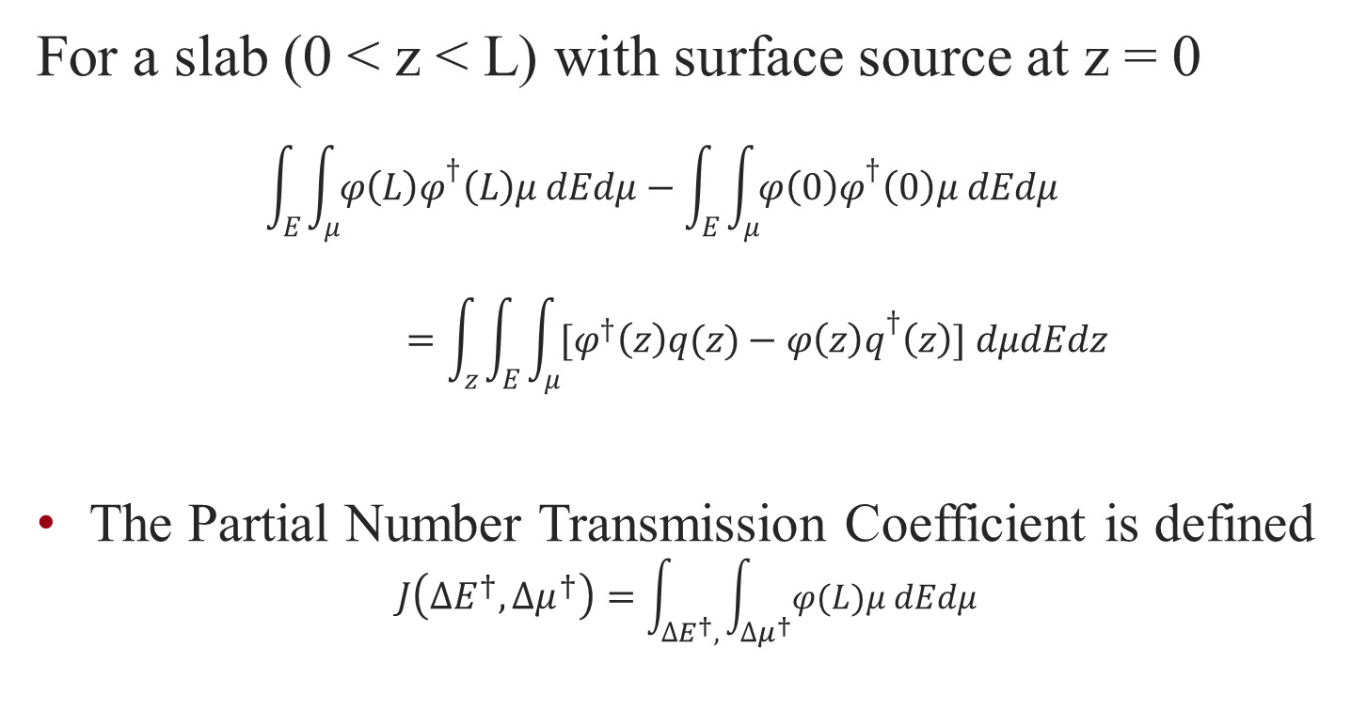
Transmission Coef for a Slab
For a slab (0 < z < L) with surface source at z = 0
$$\int_{E}{\int_{μ}{φ{\left(L\right)φ}^{†}\left(L\right)μ dEdμ}}−\int_{E}{\int_{μ}{φ{\left(0\right)φ}^{†}\left(0\right)μ dEdμ}}=\int_{z}{\int_{E}{\int_{μ}{[φ^{†}\left(z\right)q(z)−φ{\left(z\right)q}^{†}\left(z\right)] dμdEdz}}}$$
The Partial Number Transmission Coefficient is defined
$$J\left(∆E^{†},∆μ^{†}\right)=\int_{∆E^{†},}{\int_{∆μ^{†}}{φ(L)μ dEdμ}}$$

Slide 12
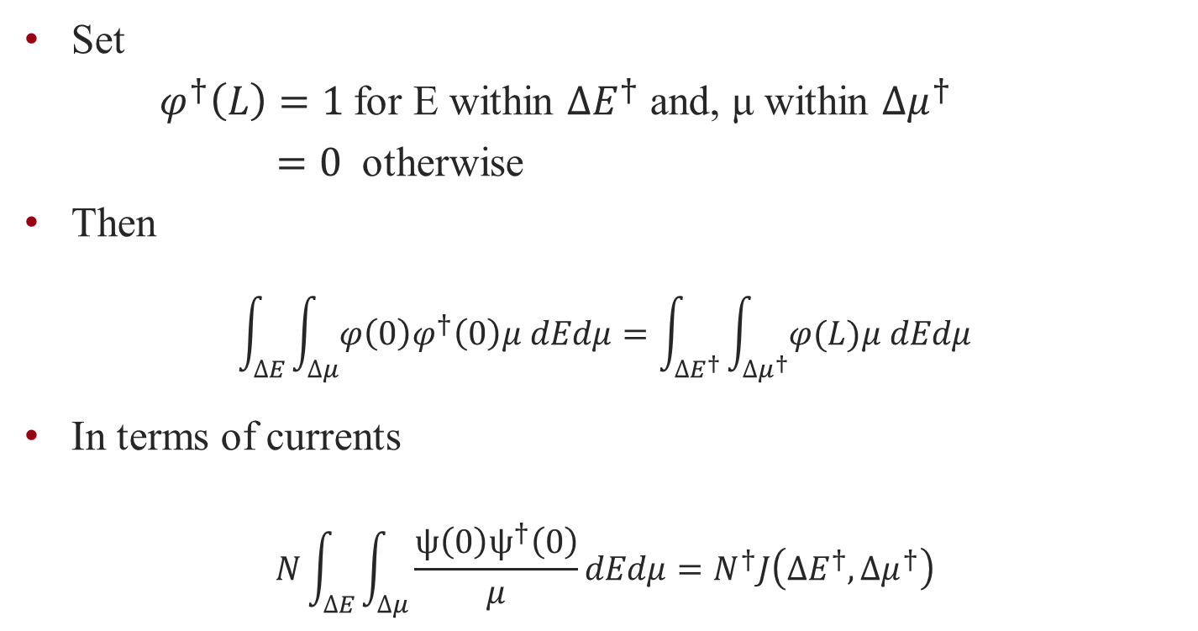
Transmission Coef for a Slab
Set
$φ^{†}\left(L\right)=1$for E within $∆E^{†}$ and, μ within $∆μ^{†}$
$=0$ otherwise
Then
$$\int_{∆E}{\int_{∆μ}{φ{\left(0\right)φ}^{†}\left(0\right)μ dEdμ}}=\int_{∆E^{†}}{\int_{∆μ^{†}}{φ(L)μ dEdμ}}$$
In terms of currents
$$N\int_{∆E}{\int_{∆μ}{\frac{ψ{\left(0\right)ψ}^{†}\left(0\right)}{μ}dEdμ}}=N^{†}J\left(∆E^{†},∆μ^{†}\right)$$

Slide 13
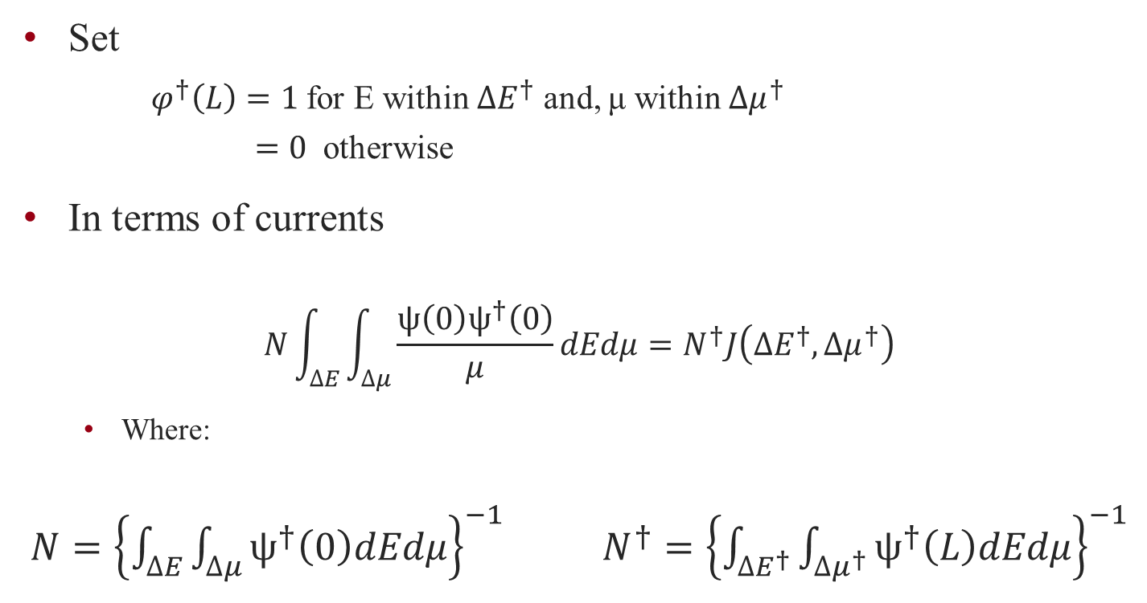
Transmission Coef for a Slab
Set
$φ^{†}\left(L\right)=1$for E within $∆E^{†}$ and, μ within $∆μ^{†}$
$=0$ otherwise
In terms of currents
$$N\int_{∆E}{\int_{∆μ}{\frac{ψ{\left(0\right)ψ}^{†}\left(0\right)}{μ}dEdμ}}=N^{†}J\left(∆E^{†},∆μ^{†}\right)$$
Where:
$N={\left\{\int_{∆E}{\int_{∆μ}{ψ^{†}\left(0\right)dEdμ}}\right\}}^{−1}$ $N^{†}={\left\{\int_{∆E^{†}}{\int_{∆μ^{†}}{ψ^{†}\left(L\right)dEdμ}}\right\}}^{−1}$

Slide 14
Results
Results agree well with the forward model
Most results agree within 1σ
Discrepancies to error in NGP approximation
Discrepancies masked with inclusion of angular scattering
Forward is favorable in calculations with a highly restrictive source (small angle and energy) and distributive response

